Slide 1



AI- Based Real -Time Sign Language Recognition and communication System Using open cv
COURSE CODE & NAME : DSA0202-Computer Vision with OpenCV
Presented by:
Gopika(192324032)
P Sai Bhavyatha (192424333)
P Hasini(192424313)
S Kamali(192524423)
R Dhanasri(192524343)
GUIDE BY:
Dr. Mayuranathan M

Slide 2


Introduction
Sign language is an important communication method for people with hearing and speech impairments.
Communication can be difficult between sign language users and people who do not understand sign language.
This project uses OpenCV and MediaPipe to detect and track hand gestures through a webcam.
21 hand landmarks are extracted and converted into a 63-feature vector.
A Random Forest classifier identifies the corresponding sign/letter.
Recognized letters are converted into text and speech for communication.
The system works in real time and provides an interactive communication interface.

Slide 3
Objectives
Collect and preprocess ASL sign language datasets.
Detect hands using MediaPipe and OpenCV.
Extract and normalize 21 hand landmarks.
Generate a 63-feature vector for classification.
Train a Random Forest classifier for sign recognition.
Evaluate the model using Accuracy, Precision, Recall and F1-Score.
Perform real-time sign recognition using a webcam.
Convert recognized signs into text and speech.

Slide 4
Problem Statement
Difficulty in communicating between sign language users and people who do not understand sign language.
Manual interpretation is time-consuming and requires a human interpreter.
Existing systems may not provide real-time recognition of individual hand signs accurately.
Recognized signs need to be converted into meaningful text and speech for easier communication.
A complete automated system is needed to detect hand signs, recognize letters, form words/sentences, and provide text-to-speech output.

Slide 5
Proposed Solution
Capture hand signs in real time using a webcam and OpenCV.
Detect and extract 21 hand landmarks using MediaPipe Hands.
Convert landmarks into normalized 63-feature vectors and classify signs using a Random Forest model.
Recognize letters and form meaningful words/sentences through an interactive communication interface.
Convert the final recognized text into speech using Text-to-Speech (TTS) for easy communication.

Slide 6
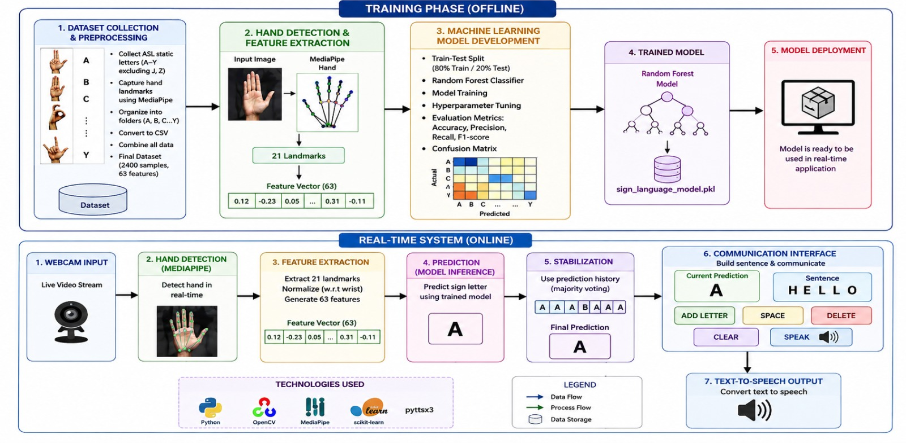
System Architecture

Slide 7
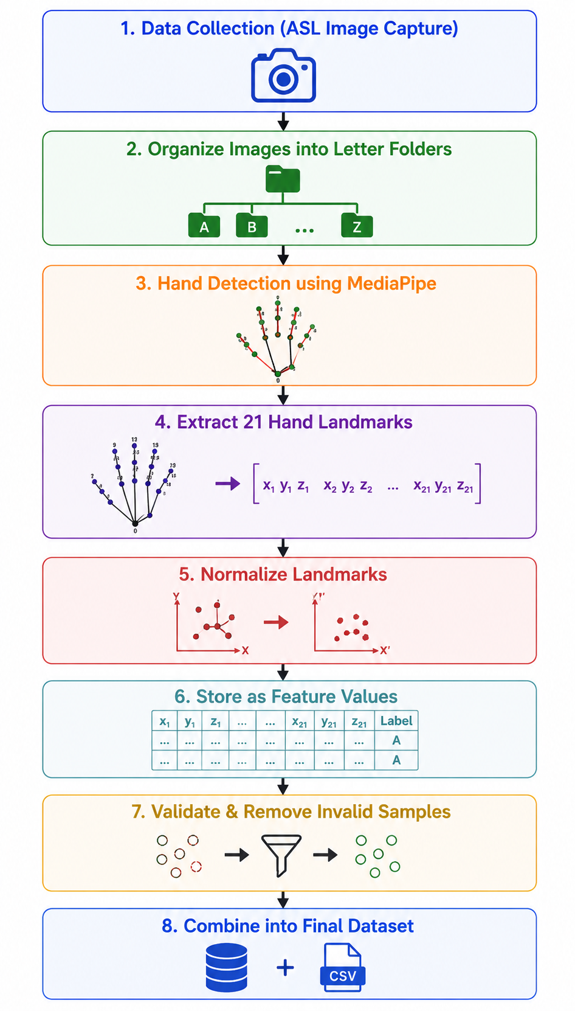
Module 1- Dataset Collection & Preprocessing
Purpose: Prepare a clean and organized dataset for training the sign language recognition model.
Collect ASL (American Sign Language) images for different letters.
Organize images into separate folders based on their corresponding letters.
Detect the hand from each image using Media Pipe.
Extract the 21 hand landmark coordinates.
Normalize the landmark coordinates to reduce the effect of hand position and size.
Store the extracted landmark data as feature values.
Validate the dataset and remove incorrect or incomplete samples.
Combine the processed data into a single dataset for machine learning.
Output: A clean dataset containing hand landmark features and their corresponding labels.

Slide 8
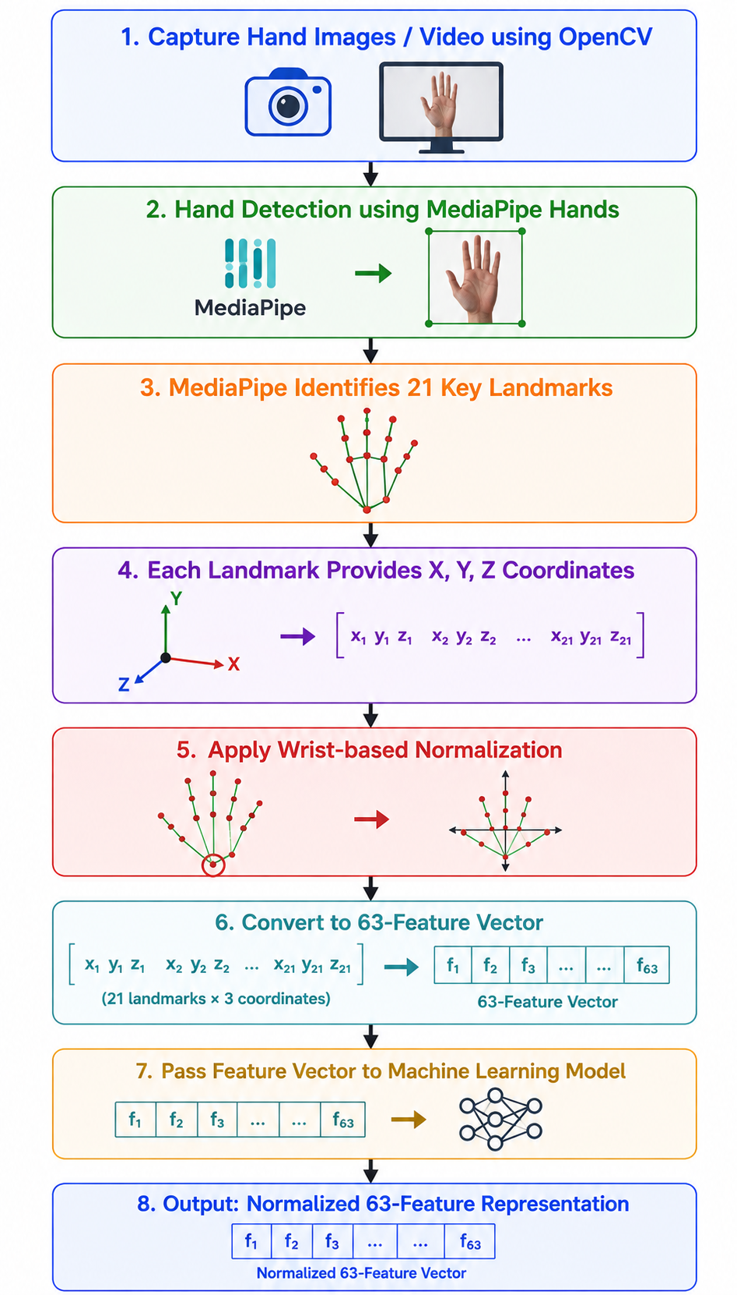
Module 2- Hand Detection & Feature Extraction
Purpose: Detect the hand and convert its shape into numerical features.
Capture hand images/video using OpenCV.
Use MediaPipe Hands for real-time hand detection.
MediaPipe identifies 21 key landmarks on the hand.
Each landmark provides X, Y, and Z coordinates.
Apply wrist-based normalization to make the features independent of hand position.
Convert 21 landmarks × 3 coordinates into a 63-feature vector.
Pass the feature vector to the machine learning model.
Output: A normalized 63-feature representation of the detected hand.

Slide 9
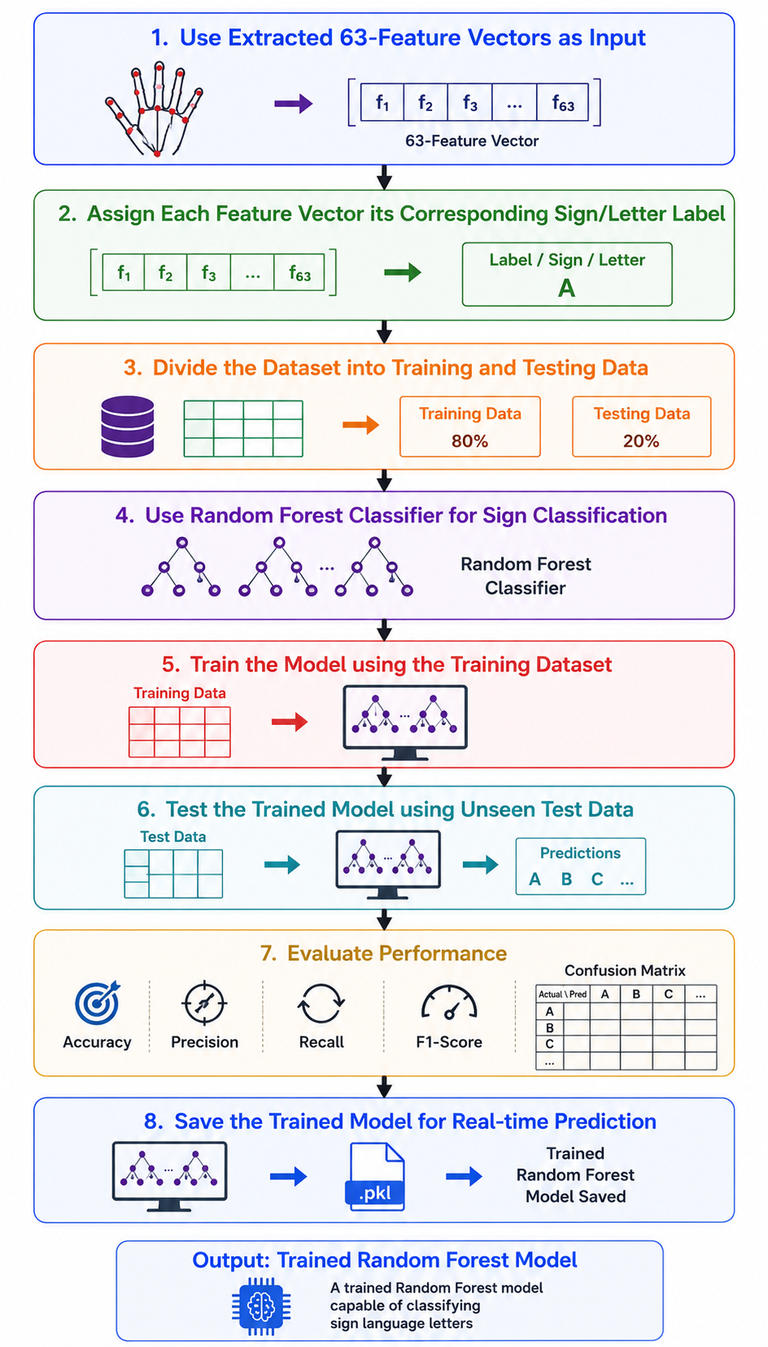
Module 3- Machine Learning Model Development
Purpose: Train a machine learning model to recognize different sign language letters.
Use the extracted 63-feature vectors as input.
Assign each feature vector its corresponding sign/letter label.
Divide the dataset into training and testing data.
Use a Random Forest Classifier for sign classification.
Train the model using the training dataset.
Test the trained model using unseen test data.
Evaluate performance using:
Accuracy ,Precision ,Recall ,F1-Score ,Confusion Matrix
Save the trained model for real-time prediction.
Output: A trained Random Forest model capable of classifying sign language letters.

Slide 10
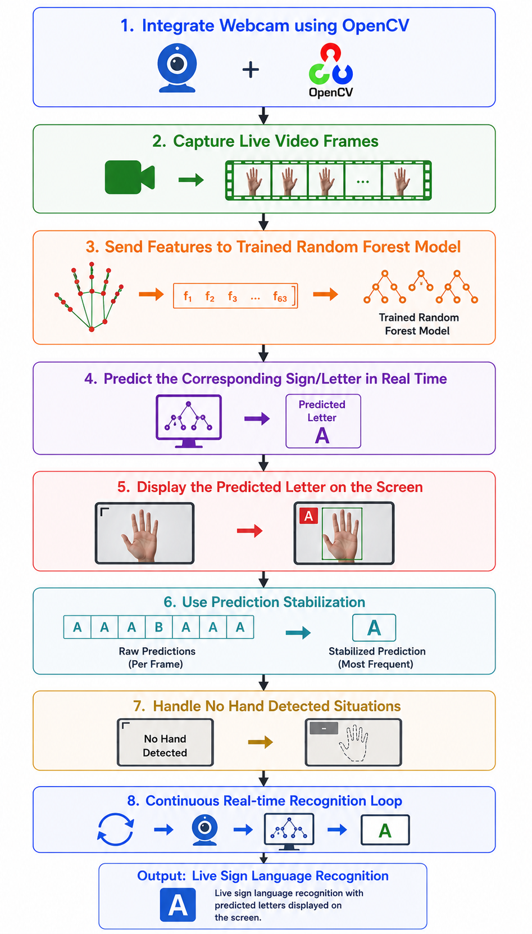
Module 4- Real-Time Sign Language Recognition
Purpose: Recognize sign language continuously through a webcam.
Integrate the webcam using OpenCV.
Capture live video frames.
Send the features to the trained Random Forest model.
Predict the corresponding sign/letter in real time.
Display the predicted letter on the screen.
Use prediction stabilization to avoid unwanted changes caused by individual frames.
Handle situations where no hand is detected.
Output: Live sign language recognition with predicted letters displayed on the screen.

Slide 11
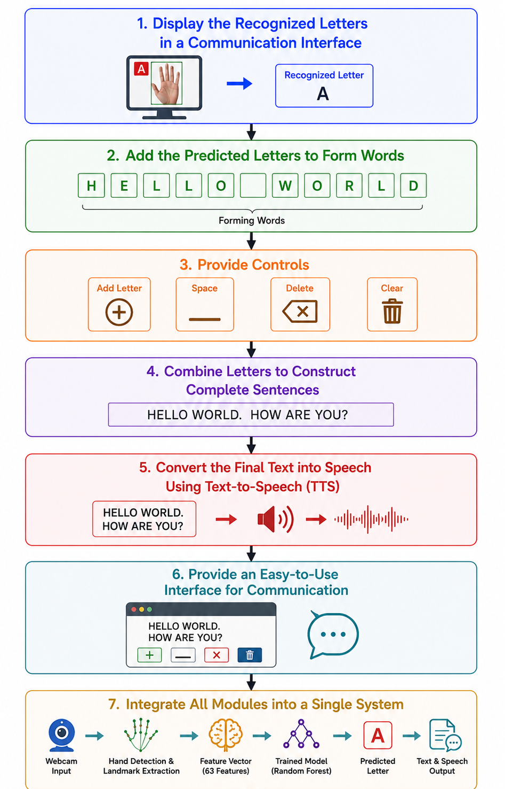
Module 5 - Communication Interface & Text-to-Speech
Purpose: Convert recognized signs into meaningful text and speech.
Display the recognized letters in a communication interface.
Add the predicted letters to form words.
Provide controls such as:
Add Letter ,Space ,Delete ,Clear
Combine letters to construct complete sentences.
Convert the final text into speech using Text-to-Speech (TTS).
Provide an easy-to-use interface for communication.
Integrate all modules into a single system.
Output: Sign language → Letter → Word → Sentence → Speech

Slide 12
Challenges & Limitations
Challenges
Lighting and background variations
Different hand positions and angles
Similar-looking gestures
Hand occlusion
Real-time processing
Prediction stability
Dataset quality
Limitations
Limited vocabulary
Mainly static signs
Webcam dependency
Environmental sensitivity
ASL-specific training
Possible classification errors
Limited contextual/grammar understanding

Slide 13
Future Enhancements
Extend the system to recognize dynamic ASL signs, including letters such as J and Z.
Expand the model to recognize complete words and commonly used sign language phrases.
Improve recognition accuracy under different lighting conditions, backgrounds, and hand orientations.
Add voice-to-text and text-to-sign capabilities for two-way communication.
Develop a mobile or web-based application for easier and more portable real-time communication.

Slide 14
Conclusion
The system successfully demonstrates real-time ASL sign language recognition using computer vision and machine learning.
MediaPipe and OpenCV enable efficient hand detection and extraction of 21 hand landmarks.
The Random Forest classifier recognizes the trained ASL letters using normalized 63-feature landmark data.
The communication interface allows recognized letters to be combined into words and sentences and converted into speech.
Overall, the project provides a practical and accessible communication solution by integrating AI, computer vision, machine learning, and Text-to-Speech technology.

Slide 15
References
Khatavkar, V., Kengar, S., Kalebere, C., & Ghute, S. (2026). A Real-Time Sign Language Recognition System Using MediaPipe and Random Forest — presents a real-time sign language recognition system using MediaPipe hand landmarks and a Random Forest classifier, with emphasis on lightweight and fast recognition. [IJACTE]
Shri Sudarsana, H., Sameera, M., Syed Irfan, M., & Thurai Pandian, M. (2026). Real-Time Sign Language to Text Conversion Using Mediapipe Hand Landmarks and Random Forest Classifier — uses 21 normalized hand landmarks extracted through MediaPipe and Random Forest for real-time recognition of static sign language gestures. [EurekaMag]
Pranav, et al. (2022). American Sign Language Recognition for Alphabets Using MediaPipe and LSTM — explores MediaPipe-based hand landmark extraction and machine learning for recognizing static and dynamic ASL alphabet gestures. [ScienceDirect]
Varanasi, A. B., Sinha, M., & Dasgupta, T. (2026). Isolated Sign Language Recognition via MediaPipe Landmarks: A Case Study on Indian Sign Language — investigates MediaPipe hand, face, and pose landmarks for efficient isolated sign language recognition and mobile deployment. [IEEE/CVF CVPR Workshops]

Slide 16
Thank You!

